Slide 1
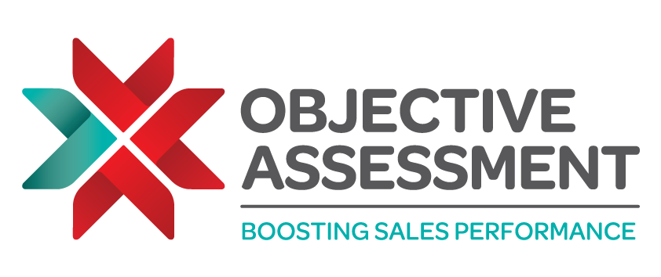
Attracting, Interviewing and Hiring Elite Sales Candidates
RECRUITING THE WRONG SALESPERSON COSTS MONEY, TIME AND EFFORT
Gary Delbridge, CEO and Founder of Objective Assessment shares his experience and insight into hiring exceptional sales talent.

Slide 2
Find and Attract Salespeople to Succeed in your Business
You’re not alone if you are struggling to attract and retain top sales talent. In fact, the recruitment of sales-people is the most problematic area for many organisations. Hiring the wrong salesperson costs more than just their recruiting and salary expenses.
As well as demotivating the team around them, a weak salesperson will have a higher cost of lost opportunities. This is the sales opportunity that a really good salesperson would have converted but a bad salesperson can’t.
The first step in sourcing new sales talent is advertising a vacancy. There are a number of ways to let salespeople know you’re looking to grow your team:
Recruiters
Recruiters can be a fantastic source for finding candidates, but they are no more qualified than you are at identifying good salespeople.
Trade Magazines and Trade Specific Websites
General Job Listing Websites
According to previous research, companies that use online job application systems get a greater number of better-quality applicants. If you don’t get the amount of candidates you had hoped for you can also search through CVs to look for suitable potential employees. Listing sites include:
Indeed Reed Monster LinkedIn Glassdoor Total Jobs CV - library
Referrals
Employees already inside your company may have previous industry colleagues that would suit your roles. Many companies offer a recruitment referral bonus to their employees who recommend a successful candidate.
Further notes:
Your recruitment advert should attract the widest pool of candidates possible. Don’t use exclusions in the ad to narrow the field of those who may apply.
Use a candidate screening tool to screen out candidates who won’t be successful rather than using the advert to do this. Find out more about the screening tool Objective Assessment uses here.
The information in this document is taken from the Objective Management Group (OMG) Recruitment Guide. Objective Assessment is a partner of OMG and provides specialist sales recruitment services.
© Copyright Objective Management Group, Inc
Find out more at www.objectiveassessment.co.uk/sales-recruitment

Slide 3
Writing an effective job advert
Most companies compose advertisements that fail to differentiate their company and opportunity from every other advertiser. They describe their company, the opportunity and the job just like everyone else. More effective job adverts describe the candidate they are looking for. Here’s an example:
“Successful, growing company has an opportunity for a motivated salesperson. Your must have prior success selling high-end conceptual solutions and products to end users at medium and large sized companies in a highly competitive market. You should have exceptional hunting and closing skills and, be effective overcoming resistance and be able to work independently without supervision…” etc.
Use the following tables help you write the specifics for you job advert:
You must have prior success:
Common text in the ad | Possible Inclusion – highlight/circle the necessary inclusions
Selling | High End/high ticket/high priced/expensive/luxury
 | Business Services/conceptual services, technical solutions, custom engineered solutions, commodities
To | Presidents, c-level, top executives, directors, management, Buyers, homeowners, owners
Of | Large corporations, Professional firms, fortune 1000 companies, small businesses, manufacturers, distributors, Hotels, government agencies, institutions, medium sized companies, retail establishments
In a | Competitive market, long sell cycle, short sell cycle, one call close, two call close.
Against an | Incumbent vendor, established vendor, industry leader, price leader
The information in this document is taken from the Objective Management Group (OMG) Recruitment Guide. Objective Assessment is a partner of OMG and provides specialist sales recruitment services.
© Copyright Objective Management Group, Inc
Find out more at www.objectiveassessment.co.uk/sales-recruitment

Slide 4
You must:
Common text in the ad | Possible Inclusion – highlight/circle the necessary inclusions
Excel at | Finding and closing new opportunities, finding new opportunities, building relationships, growing existing accounts, servicing existing accounts
And have | Strong closing skills, excellent listening skills, excellent analytical skills, excellent problem-solving skills, consultative selling skills
You Should:
Common text in the ad | Possible Inclusion – highlight/circle the necessary inclusions
Be | A self starter, highly motivated, goal orientated, memorable, passionate, a high achiever, a hard worker,
And | Work without supervision, work well as part of a team, be willing to travel X% of the time.
Experience with X (use type or size example of competitive business or industries that can also serve to mask your own business) helpful but not required.
The information in this document is taken from the Objective Management Group (OMG) Recruitment Guide. Objective Assessment is a partner of OMG and provides specialist sales recruitment services.
© Copyright Objective Management Group, Inc
Find out more at www.objectiveassessment.co.uk/sales-recruitment

Slide 5
Interviewing Sales Candidates
The interview is an opportunity to meet, observe and question a viable candidate who has met all of the preliminary requirements for a position.
The interview is not the time to verify information on the employment application, the length of previous employment or a candidate’s interest in the position. Be tough in the first interview. Salespeople face tough situations. You’ll never have a better opportunity to see how well they handle tough situations than in the first interview.
Suggested interview sequence:
Introduction
CV questioning
Assessment questioning
General questioning
End interview
Interview tips:
Do not attempt to develop rapport. The only way you’ll learn if they can do it is to let them try.
Keep candidates on the defensive. That way you’ll know how the candidate will respond with tough prospects.
Be professional and respectful.
Be very direct.
End the interview if you know that you won’t be hiring them.
Do not become emotional.
Two sets of eyes are better than one. The interview should include two interviewers, or you should conduct two interviews with different interviewers in each one.
The information in this document is taken from the Objective Management Group (OMG) Recruitment Guide. Objective Assessment is a partner of OMG and provides specialist sales recruitment services.
© Copyright Objective Management Group, Inc
Find out more at www.objectiveassessment.co.uk/sales-recruitment

Slide 6
Inventory of Interview Questions:
Question | Rate their response (1-5)
Why are you looking for a new position?
Why did you leave your last job?
What interested you about this position?
What was it about the ad?
Please share your earning history.
Please provide the breakdown of salary vs. commission
What would the perfect sales position entail?
What's the single most difficult thing about you that you have changed?
What’s the best example of you can give me about overcoming adversity?
Why have you been successful?
What could you have done to be more successful?
Why do customers like you?
Why do customers trust you?
Please describe a typical day in your sales life.
What do you bring to the table that’s unique?
Average score
The information in this document is taken from the Objective Management Group (OMG) Recruitment Guide. Objective Assessment is a partner of OMG and provides specialist sales recruitment services.
© Copyright Objective Management Group, Inc
Find out more at www.objectiveassessment.co.uk/sales-recruitment

Slide 7
The first 90 days – managing a new salesperson
During the first 90 days of your new salesperson’s employment the following topics should be addressed:
Typical customers/clients
Typical markets
Problems solved by the product/service
Comparison to the Competition
Product and service training to develop a conceptual knowledge of business problems solved by products and services with a specific timeframe scheduled daily; progress test along the way
Implement a daily activity tracking system.
Review of progress re: intra-company interpersonal relationship building with special attention given to problem areas.
Identification of and discussion of any unexpected obstacles and what to do about them.
Sales training – issues to be addressed, when and by whom
Begin pipeline development
The prospecting call – what does it sound like in your business?
The sales call - flow, steps, milestones, competition , objections, positioning in the marketplace, coaching – who will provide the coaching and how often
Accountability – who will hold them accountable and what will be measured
Develop personal goals and a plan along with daily activity measures.
Joint sales call - salesperson as observer
Joint sales call – salesperson being observed
Hopefully, you will have discovered that you have hired a salesperson who is stronger than you. While some sales managers feel threatened by this, the reality is that you couldn’t be any more fortunate. Your success will be in direct relation to the strength of your salespeople.
Expectations- if this is the first time that you have “A” players on your team, expect them to be more confident, self directed, productive and effective. But don’t expect them to be any better at self – starting than “b” players. You’ll still have to set expectations and guidelines and hold them accountable.
Challenges – strong salespeople can also be strong-willed and may attempt to impose their ideas on you. If they suggest changes this is a good thing, not a bad thing, simply tell them that you are aware of their successful history, excited about their employment here and look forward to discussing their suggestions as soon as they experience success at your company.
The information in this document is taken from the Objective Management Group (OMG) Recruitment Guide. Objective Assessment is a partner of OMG and provides specialist sales recruitment services.
© Copyright Objective Management Group, Inc
Find out more at www.objectiveassessment.co.uk/sales-recruitment

Slide 8
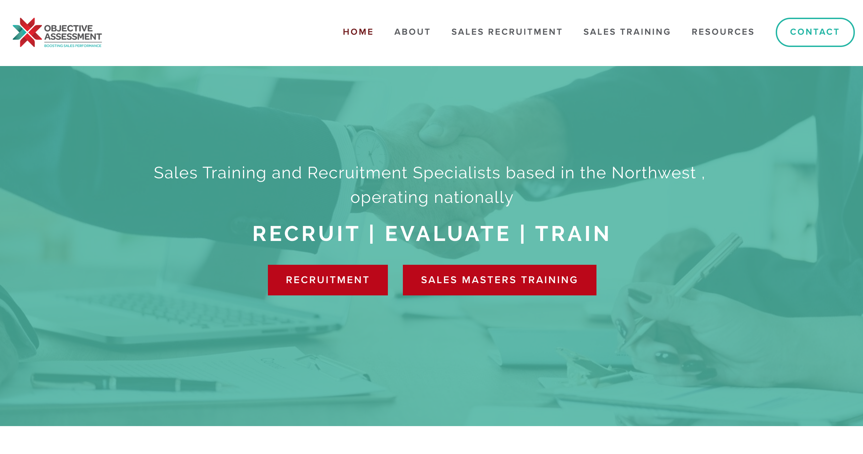
Final tips
Good candidates have choices. Once you have decided that they are the right one for the role, don’t procrastinate. Make an offer and get them on-board without delay or else you will lose them.
You have 90 days in which to decide whether they are right for the job and have what it takes. Have clear agreed expectations of performance in that 90 days included the training you will provide. If they fail to hit the agreed targets, cut your losses and start again.
As their manager, take total responsibility for their induction and coach them in the behaviours and activities that you expect from them.
Be honest. There’s nothing worst than losing a great salesperson because you have promised the earth and failed to deliver. Paint a true picture for candidates rather than a rosy one. This is a strong indicator of your culture.
To find out more about Objective Assessment’s Recruitment services please contact us for a no-obligation chat:
Email: info@objectiveassessment.co.uk
Call: 01695 589555
Or Find out more about the Objective Assessment Recruitment Process on our website
The information in this document is taken from the Objective Management Group (OMG) Recruitment Guide. Objective Assessment is a partner of OMG and provides specialist sales recruitment services.
© Copyright Objective Management Group, Inc
Find out more at www.objectiveassessment.co.uk/sales-recruitment

